Slide 1
SQL Basic operations

Slide 2
Arithmetic Operators
ADDITION
SUBTRACTION
DIVISION
MULTIPLICATION

Slide 3
Create table emp (ename varchar(10),salary(10));
Insert into emp values(‘bhavneet’,2000);
Select ename, salary+1000 from emp;
Select ename, salary-1000 from emp;
Select ename, salary*1000 from emp;
Select ename, salary+1000 from emp;
Select ename, salary/1000 from emp;

Slide 4
Few Examples of operators:
Select employeefirstname, salary+1000 from employee;
Select employeefirstname, salary-5000 from employee;
Select employeefirstname, salary*2 from employee;
Select employeefirstname, salary/2 from employee;

Slide 5
Alias with Select Command
SQL aliases are used to give a table, or a column in a table, a temporary name.
Alias is used to rename the column name while displaying data. But the actual column name in the structure does not change.
Aliases are often used to make column names more readable.
An alias only exists for the duration of that query.
An alias is created with the AS keyword.

Slide 6
Alias Column Syntax
SELECT column_name AS alias_name
FROM table_name;
Alias Table Syntax
SELECT column_name(s)
FROM table_name AS alias_name;

Slide 7
Examples-
SELECT CustomerID AS ID, CustomerName AS Customer
FROM Customers;

Slide 8

Example of Employee table
The following SQL statement creates two aliases: one for the EMPLOYEEFIRSTNAME column and one for the EMPLOYEELASTNAME column:
Select EMPLOYEEFIRSTNAME AS Firstname, EMPLOYEELASTNAME AS Lastname FROM employee;

Slide 9

Contd….
Select EMPLOYEEFIRSTNAME AS Firstname, EMPLOYEELASTNAME AS Lastname FROM employee;
Result for above query will be:

Slide 10
The following SQL statement creates two aliases, one for the CustomerName column and one for the ContactName column.
Note: It requires double quotation marks or square brackets if the alias name contains spaces
SELECT employeeid AS id, employeefirstname AS "employee first name" FROM employee;
Or
SELECT employeeid AS id, employeefirstname AS [employee first name]
FROM employee;

Slide 11
Concatenation Operator
Represented by vertical Bars
Concatenates columns or character strings to others and creates the resultant column .
SYNTAX: select column-name1|| column-name2 from table-name;

Slide 12

For example:
select employeefirstname||employeelastname from employee;

Slide 13
Select command with Between Operator
Between operator is used to select the data that is within a specified range of values.
It returns only those values which have values within lower and upper limit.
SYNTAX: select * from tablename where column-name between lower limit and upper limit;
Select * from emp where salary between 10000 and 12000;

Slide 14

For example:
Considering example of Employee table:
Select * from employee where salary between 10000 and 17000;

Slide 15

Contd….

Slide 16
Select Command With Like Operator
The LIKE operator is used in a WHERE clause to search for a specified pattern in a column.
There are two wildcards often used in conjunction with the LIKE operator:
  % - The percent sign represents zero, one, or multiple characters
  _ - The underscore represents a single character
LIKE Syntax
  SELECT column1, column2, ...
  FROM table_name
  WHERE columnN LIKE pattern;

Slide 17
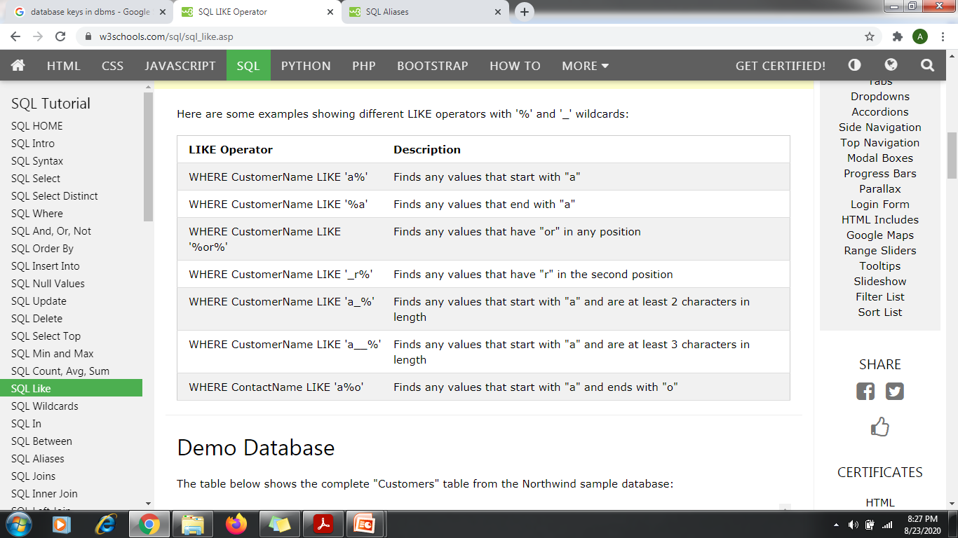

Slide 18
select employeefirstname, employeelastname from employee where address like 'd%';
select employeefirstname, employeelastname from employee where address like '%i';
select * from employee where address like '%el%';
select employeefirstname, employeelastname from employee where address like '_h%';

Slide 19
select employeefirstname, employeelastname from employee where address like 'c_%';
select employeefirstname, employeelastname from employee where address like 'd__%';
select employeefirstname, employeelastname from employee where address like 'c%h';
select * from employee where address like 'd%i';

Slide 20
FEW EXAMPLES OF LIKE OPERATOR

Slide 21
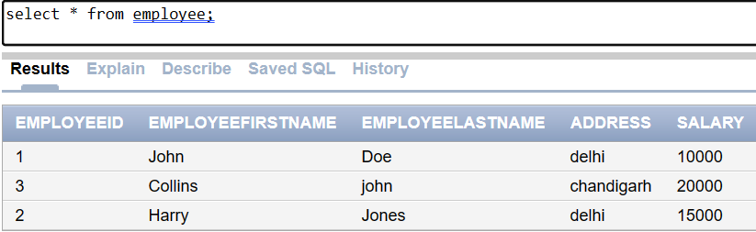
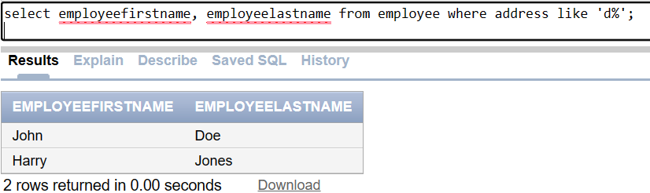

Slide 22

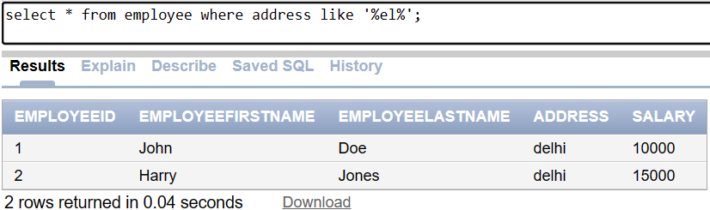

Slide 23
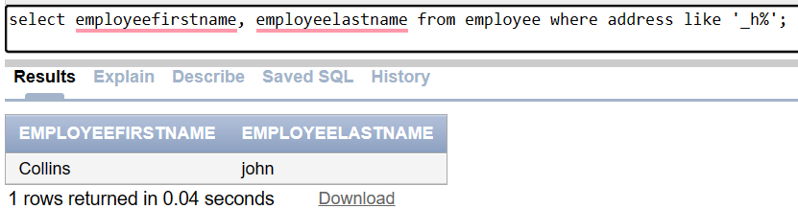
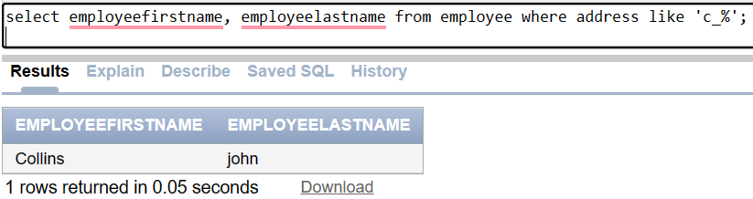

Slide 24
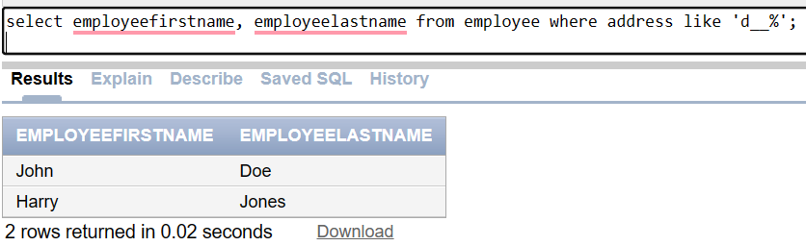
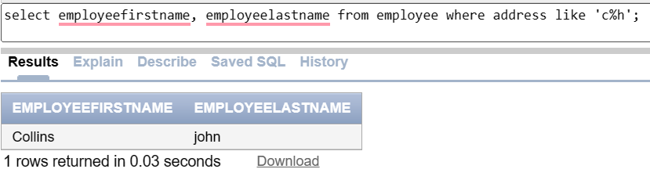

Slide 25
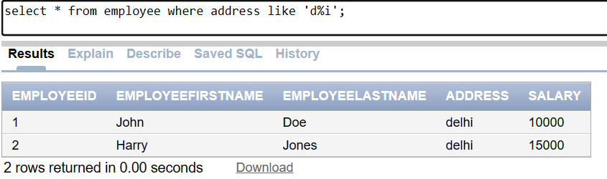

Slide 26
Few examples using Aliases for tables:
For example, consider the following SQL query:
SELECT first_name, last_name, salary FROM employees WHERE department = 'Marketing';
Using aliases, the query can be written as:
SELECT e.first_name, e.last_name, e.salary FROM employees e WHERE e.department = 'Marketing';

Slide 27
Contd…
In this query, "e" is the alias for the "employees" table. The aliases "first_name", "last_name", and "salary" are used to provide a more descriptive name to the corresponding columns.
Aliases can also be used when joining tables in SQL to distinguish between identically named columns in different tables.

Slide 28
Example using Employee table:
SELECT employeefirstname, employeelastname, salary FROM employee WHERE address = 'delhi';
Select e.employeefirstname, e.employeelastname, e.salary from employee e where e.address ='delhi';

Slide 29
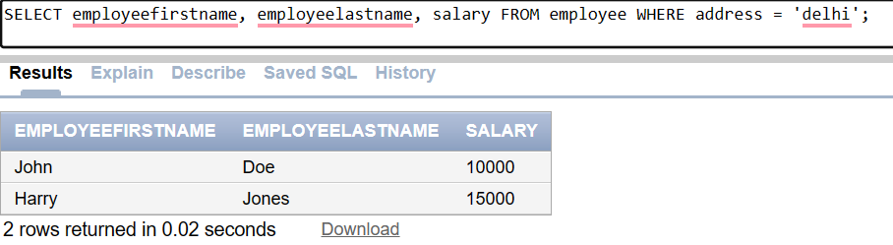
Contd..
Results of queries:

Slide 30
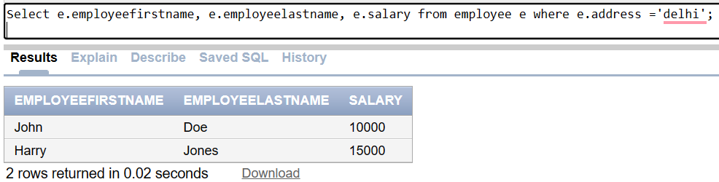

Slide 31

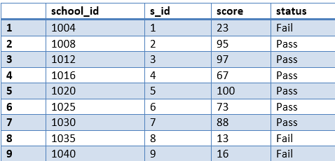
Example table: School

